Slide 1
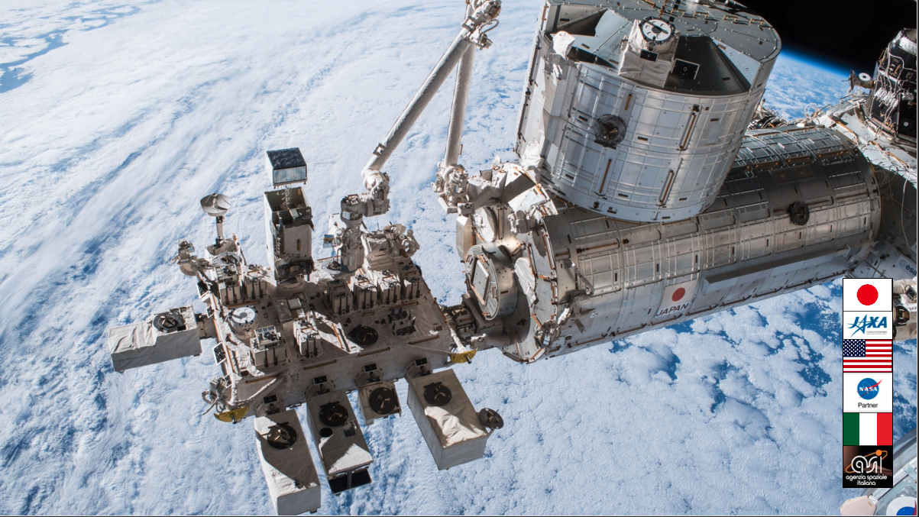
ISS搭載CALETによる
６年間の軌道上観測の成果
Calorimetric
Electron
Telescope
on the International Space Station
鳥居祥二
早稲田大学理工総研
他CALET国際研究チーム
令和３年度ISEE 合同研究集会 2022年3月2日

Slide 2
The CALET Collaboration Member
PI : Japan
Co-PI : Italy
Co-PI : USA

Slide 3





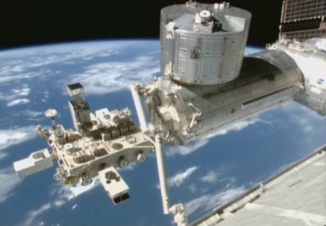
CALET Payload
Kounotori (HTV) 5
CGBM (CALET Gamma-ray Burst Monitor)
FRGF (Flight Releasable Grapple Fixture)
ASC (Advanced Stellar Compass)
Calorimeter
GPSR (GPS Receiver)
Launched on Aug. 19th, 2015
by the Japanese H2-B rocket
Emplaced on JEM-EF port #9
on Aug. 25th, 2015
MDC (Mission Data Controller)
・ Mass: 612.8 kg
・ JEM Standard Payload Size:
1850mm(L) × 800mm(W) × 1000mm(H)
・ Power Consumption: 507 W（max）
・ Telemetry:
Medium 600 kbps (6.5GB/day) / Low 50 kbps
JEM/Port #9

Slide 4
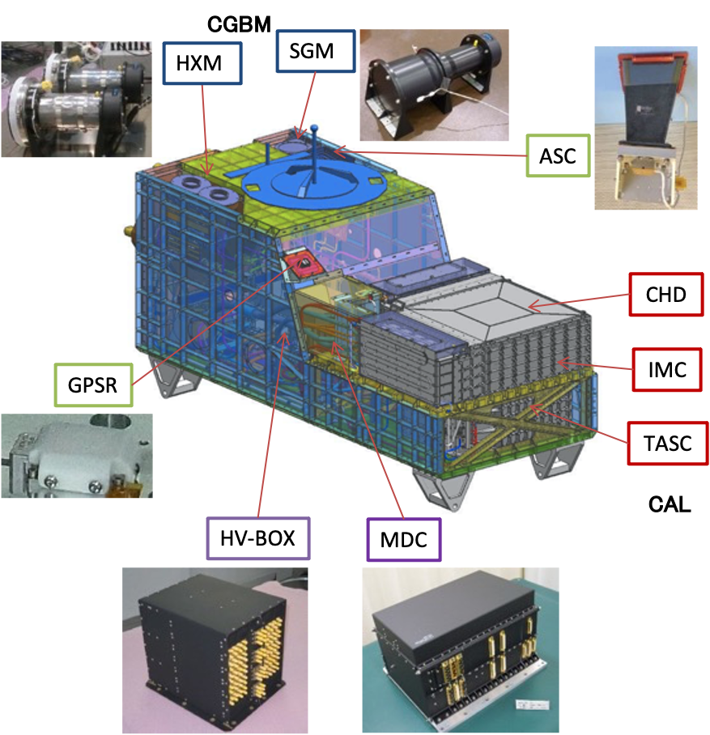
Overview of CALET Payload
CAL
・Charge Detector (CHD) ・Imaging Calorimeter (IMC) ・Total Absorption Calorimeter (TASC)
CGBM
・Hard X-ray Monitor (HXM) x 2 LaBr₃ : 7keV～1MeV ・Soft γ-ray Monitor (SGM) BGO ： 100keV～20MeV
Data Processing & Power Supply
・Mission Data Controller (MDC) CPU, telemetry, power, trigger etc. ・HV-BOX (Italian contribution) HV supply（PMT:68ch, APD:22ch）
Support Sensors
・Advanced Stellar Compass (ASC) Directional measurement ・GPS Receiver (GPSR) Time stamp of triggered event（<1ms）

Slide 5

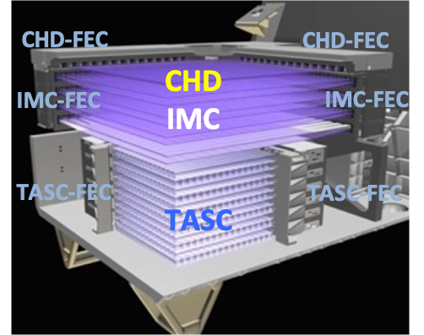
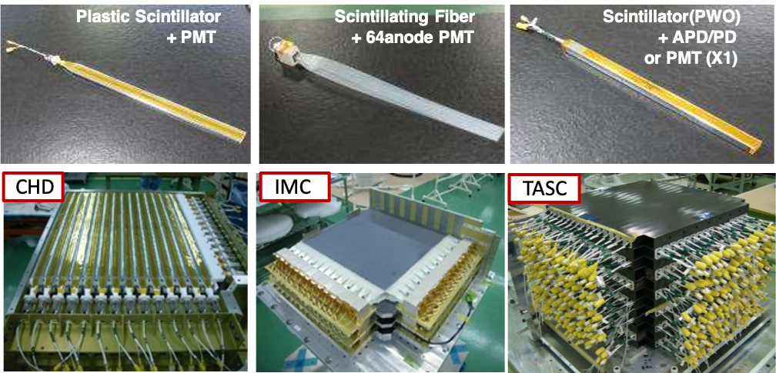
CALET Detector: Calorimeter
 | CHD (Charge Detector) | IMC (Imaging Calorimeter) | TASC (Total Absorption Calorimeter)
Measure | Charge (Z=1-40) | Tracking , Particle ID | Energy, e/p Separation
Geometry (Material) | Plastic Scintillator 14 paddles x 2 layers (X,Y): 28 paddles Paddle Size: 32 x 10 x 450 mm³ | 448 Scifi x 16 layers (X,Y) : 7168 Scifi 7 W layers (3X₀): 0.2X₀ x 5 + 1X₀ x2 Scifi size : 1 x 1 x 448 mm³ | 16 PWO logs x 12 layers (x,y): 192 logs log size: 19 x 20 x 326 mm³ Total Thickness : 27 X₀ , ~1.2 λ_{I}
Readout | PMT+CSA | 64-anode PMT + ASIC (VA32-HDR) | APD/PD+CSA PMT+CSA (for Trigger)@top layer

Slide 6
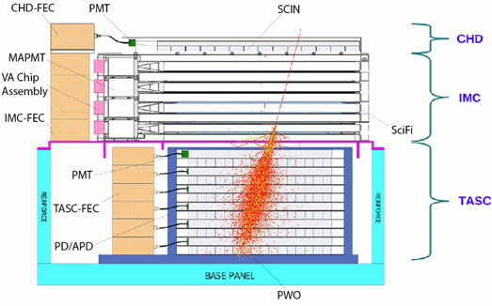
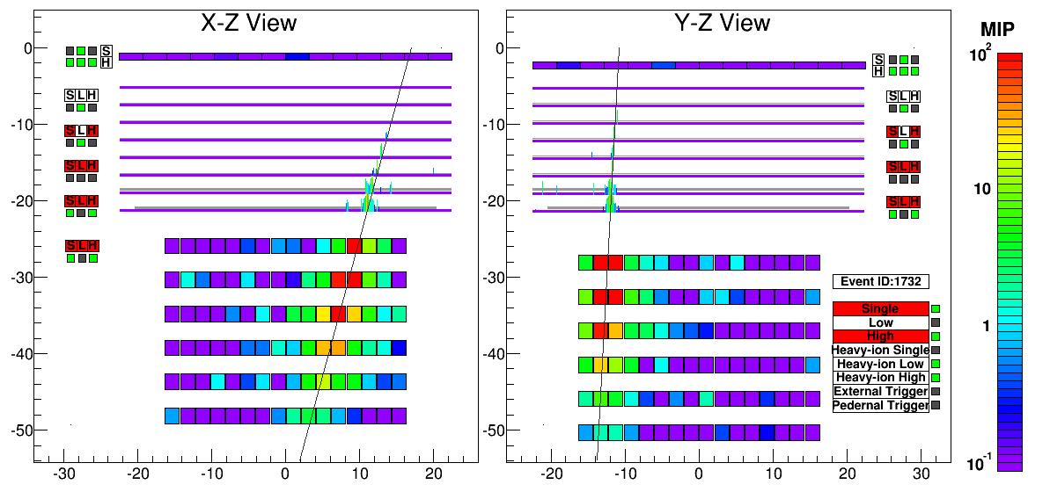
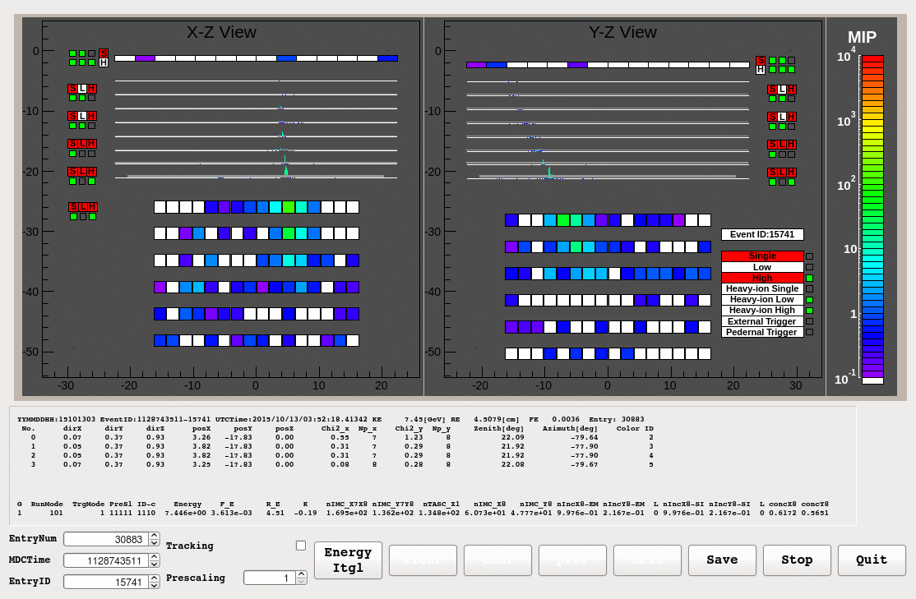
CALET Calorimeter and Capability
Field of view: ~ 45 degrees (from the zenith) Geometrical Factor: ~ 1,040 cm²sr (for electrons)
45 cm
1 TeV electron shower
CHD – Charge Detector
- 2 layers x 14 plastic scintillating paddles
- single element charge ID from p to Fe and above (Z = 40)
- charge resolution ~0.1-0.3 e
IMC – Imaging Calorimeter
- Scifi + Tungsten absorbers: 3 X₀ at normal incidence
- 8 x 2 x 448 plastic scintillating fibers (1mm) readout individually
- Tracking ( ~0.1° angular resolution) + Shower imaging
TASC – Total Absorption Calorimeter 27 X_{0,} 1.2 λ_{Ι}
- 6 x 2 x 16 lead tungstate (PbWO₄) logs
- Energy resolution: ~2 % (>10GeV) for e , γ ~30-35% for p, nuclei
- e/p separation: ~10⁻⁵
Electron, E=3.05 TeV
Gamma-ray, E=44.3 GeV
Proton, E_{TASC}=2.89 TeV
Iron, E_{TASC} =9.3 TeV
Event Display: Electron Candidate (>100 GeV)

Slide 7
CALET Overview
Geometrical Factor:
1040 cm² sr for electrons, light nuclei
1000 cm² sr for gamma-rays
4000 cm²sr for ultra-heavy nuclei
ΔE/E:
~2 % (>10GeV) for e , γ
~30-35% for protons, nuclei
e/p separation: ~10⁵
Charge resolution: 0.15-3 e (p-Fe)
Angular resolution:
0.2°for gamma-rays > ~50 GeV
Electron observation in 1GeV-20TeV
Design optimized for electron detection:
high energy resolution and large e/p separation power
+ electromagnetic shower containment
Search for Dark Matter and Nearby Sources
Observation of cosmic-rays in 10 GeV-1 PeV
CR acceleration and propagation mechanism(s)
Detection of transient phenomena in space:
Gamma-ray burst
GW e.m. counterparts
Solar modulation
Space weather
Detector
performance
Scientific
objectives
Scientific Objectives | Observation Targets | Energy Range
CR Origin and Acceleration | Electron spectrum Individual spectra of elements from proton to Fe Ultra Heavy Ions (26<Z≤40) Gamma-rays (Diffuse + Point sources) | 1GeV - 20 TeV 10 GeV - 1000 TeV > 600 MeV/n 1 GeV - 1 TeV
Galactic CR Propagation | B/C and sub-Fe/Fe ratios | Up to some TeV/n
Nearby CR Sources | Electron spectrum | 100 GeV - 20 TeV
Dark Matter | Signatures in electron/gamma-ray spectra | 100 GeV - 20 TeV
Solar Physics | Electron ﬂux (1GeV-10GeV) | < 10 GeV
Gamma-­ray Transients | Gamma-­rays and X-rays | 7 keV - 20 MeV

Slide 8

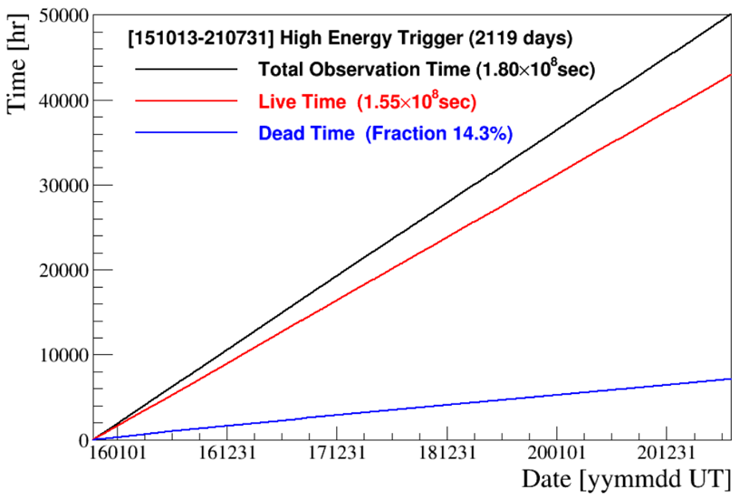
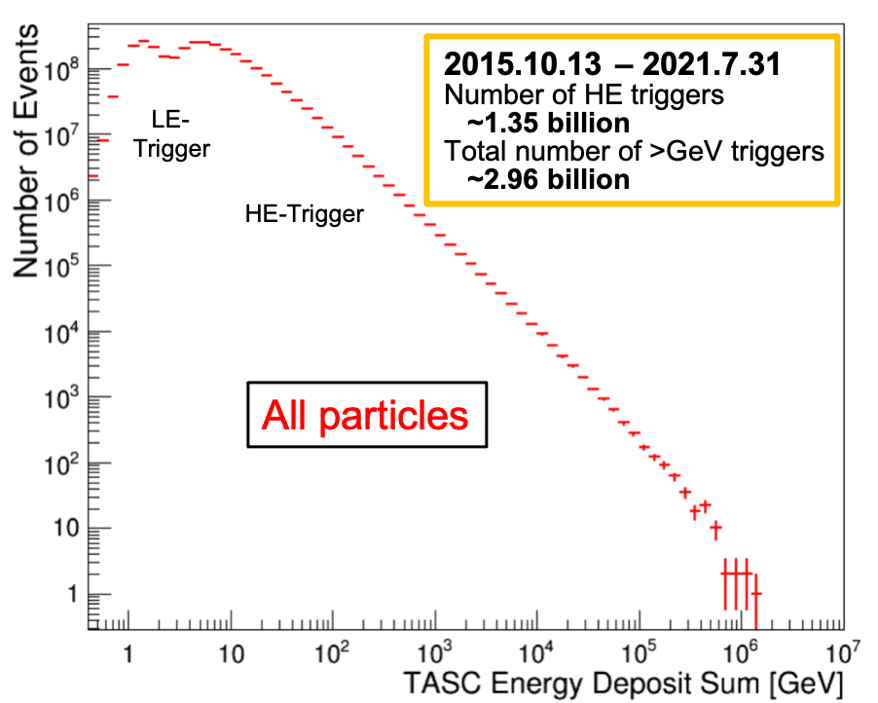
CALET Observations on the ISS
Accumulated observation time (live, dead)
Energy deposit (in TASC) spectrum: 1 GeV-1 PeV
Trigger Rate : ~ 8.7 Hz
High-energy trigger (> 10 GeV) statistics:
Operational time > 2119 days^{(*)}
(*) as of July 31, 2021
Live time fraction > 85%
Exposure of HE trigger
~186 m² sr day
HE-gamma point source exposure
~3.6 m² day (for Crab, Geminga)

Slide 9

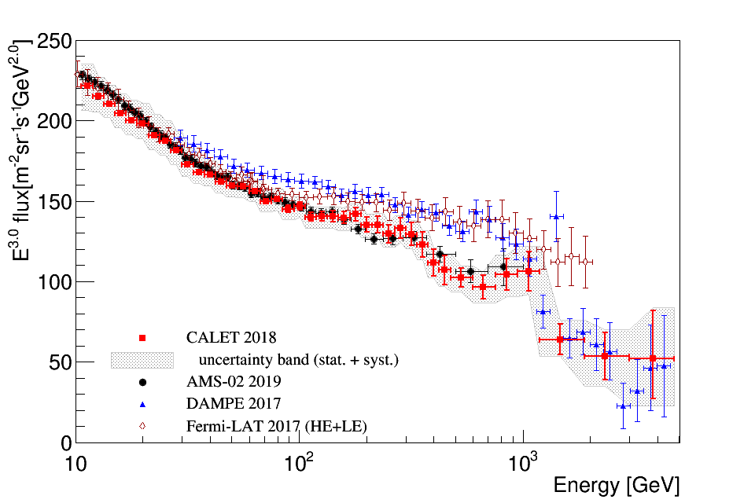
Cosmic-ray All-electron Spectrum
Phys. Rev. Lett. 120, 261102 (2018)
Below 1 TeV: CALET spectrum is consistent with AMS-02
Present measurements cluster into 2 groups:
AMS02 + CALET and FERMI + DAMPE
possibly indicating the presence of unknown systematics
[11 GeV, 4.8 TeV]
Above 1 TeV CALET observes a suppression of the flux consistent with DAMPE within errors
No peak-like structure at 1.4 TeV in CALET measurement irrespective of binning

Slide 10
Cosmic-ray all-electron spectrum (update: as of Sep. 30, 2020)
Phys. Rev. Lett. 120, 261102 (2018)
Preliminary spectrum is updated after 1815 days of CALET observations:
Oct.13, 2015 - Sep.30, 2020
Low energy region: solar modulation
=> better consistency with AMS-02 (2019)
CALET - Preliminary
CALET 2021
uncertainty band (stat.+syst.)
AMS-02 2019
DAMPE 2017
Fermi-LAT 2017 (HE+LE)

Slide 11
Cosmic-ray all-electron spectrum (update: as of Sep. 30, 2020)
Phys. Rev. Lett. 120, 261102 (2018)
High energy region: statistics increased x 2.3
[11 GeV, 4.8 TeV]
CALET - Preliminary
CALET observes a flux
suppression above 1 TeV
with a significance > 6.5 σ,
a considerable improvement
with respect to the result
published in PRL2018 (~4 σ)

Slide 12
Towards an interpretation of the CALET all-electron spectrum

Slide 13
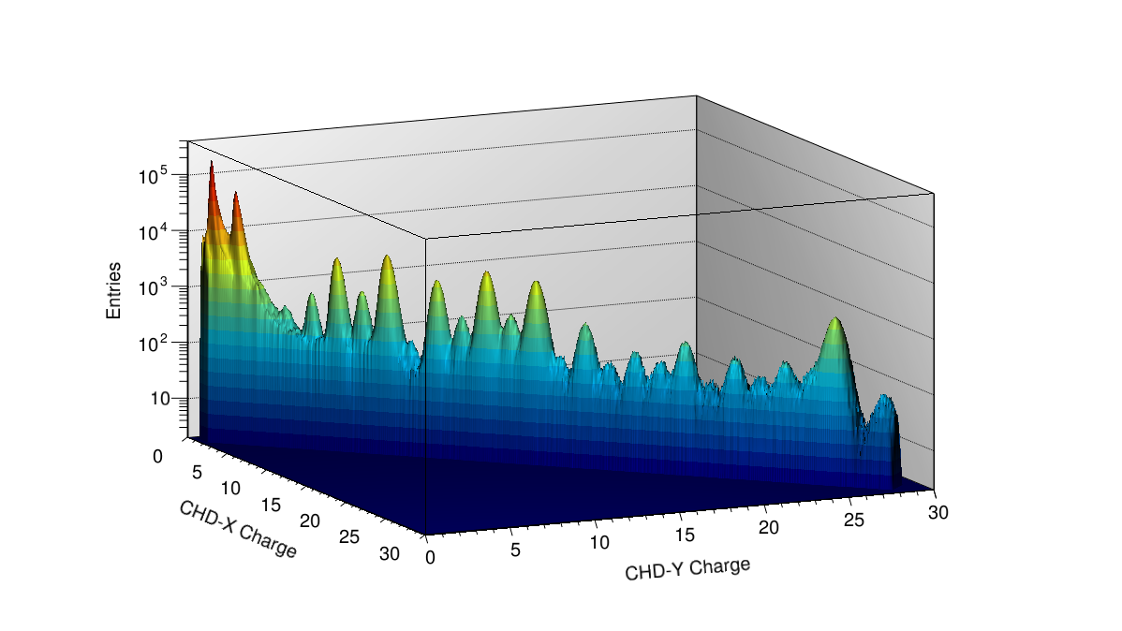
Charge Identification with CHD and IMC
Single element identification for p, He and light
nuclei is achieved by CHD+IMC charge analysis.
p
He
Charge separation in B to C : ~7 σ
CHD charge resolution
(2 layers combined vs. Z)
Charge separation in B to C : ~5 σ
H
He
Li
C
O
Ne
Mg
Si
B
N
Be
F
Na
Al
S
Fe
P
Cl
Ar
Ca
Ti
Cr
K
Sc
V
Ni
IMC charge resolution with multiple
dE/dx sampling in scintillating ﬁbers
Deviation from Z² response is corrected both in CHD and IMC using a core + halo ionization model (Voltz)
13

Slide 14
Cosmic-ray proton spectrum
2018: CALET confirms proton spectral hardening
above a few hundred GeV with a deviation from a
single power law at >3σ
CALET covers the whole range [50 GeV, 10 TeV] with the same instrument

Slide 15
Cosmic-ray proton spectrum
2018: CALET confirms proton spectral hardening
above a few hundred GeV with a deviation from a
single power law at >3σ
Energy ranges 50 GeV – 500 GeV and 1 TeV – 10 TeV can each be fitted with single power laws
Progressive hardening up to TeV energies
Smoothly-broken power law fit gives low energy index consistent with AMS-02, but larger change in index and higher break energy

Slide 16
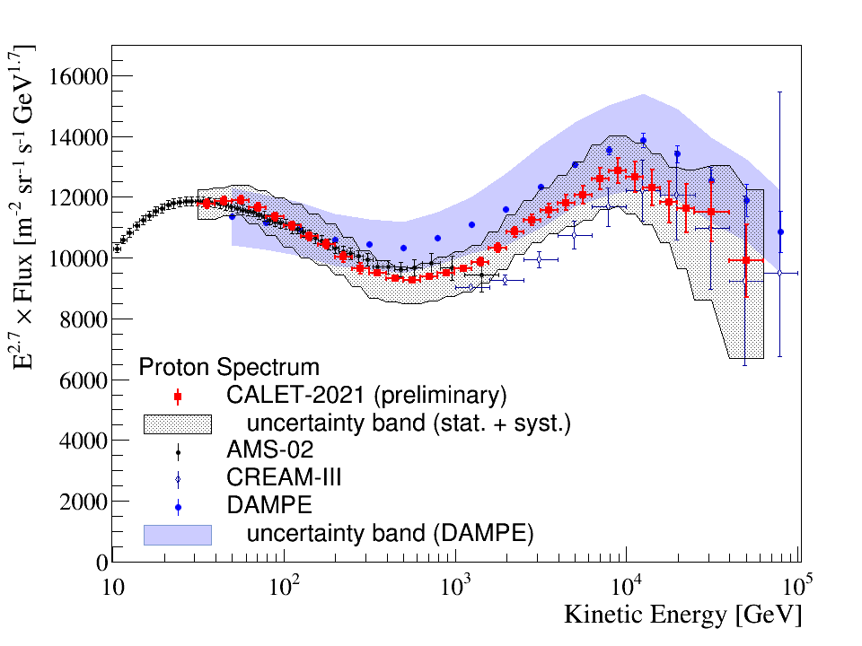
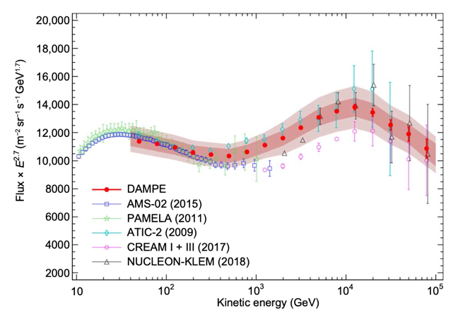


Cosmic-ray proton spectrum (update: as of Sep.30, 2020)
DAMPE: Sci. Adv. 2019;5 (2019)
CALET Preliminary
[50 GeV, 50TeV]
[30 GeV, 60 TeV]
- DAMPE reported a spectral index
softening from
~-2.60 to ~-2.85. above 10 TeV at
E_{break} = with ~30% error.
- DAMPE flux is consistent with AMS-02
and CALET up to 200 GeV. Above, the
flux is higher (close to the limit of
the systematic error band ).

Slide 17
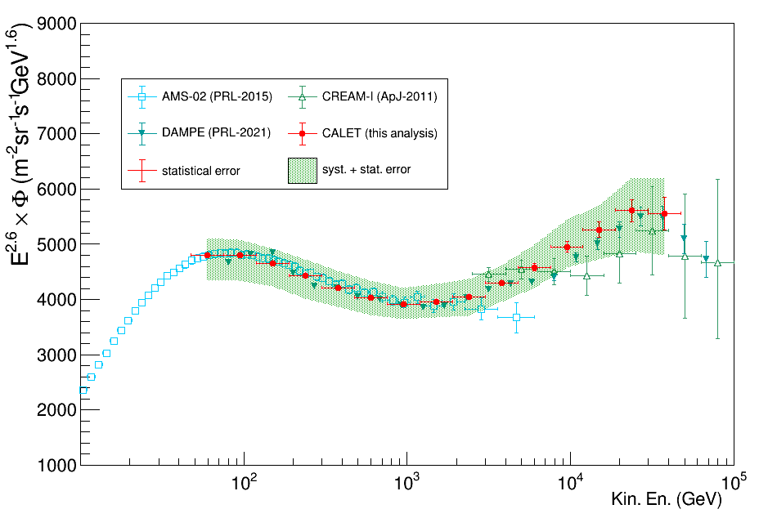
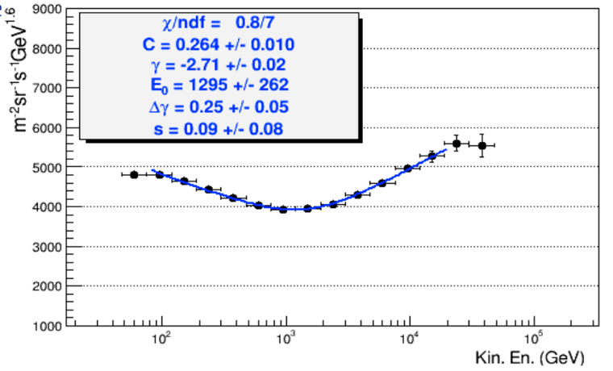
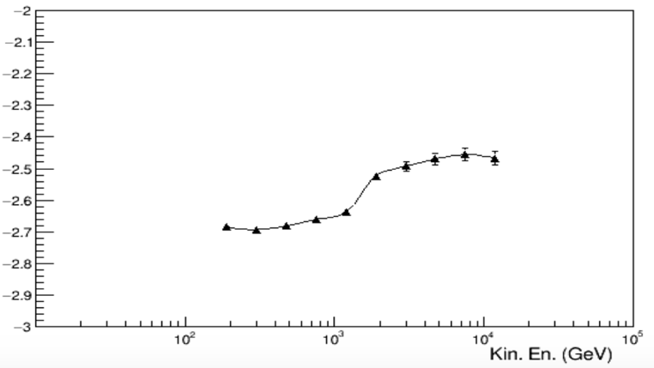
Cosmic-ray helium spectrum (preliminary)
DAMPE: Sci. Adv. 2019;5 (2019)
statistical errors only
PRELIMINARY
PRELIMINARY
[50 GeV, 50 TeV]
a spectral hardening is observed with helium
around ~1.3 TeV total kinetic energy
(*)
energy dependence of the helium spectral index
fitting the spectrum inside a sliding window
Statistical errors only
CALET preliminary helium flux is consistent with DAMPE
within the errors from ~60 GeV to ~60 TeV.
(present analysis: ~ 50% reduced acceptance inside fiducial region ~ 510 cm² sr)
PRELIMINARY

Slide 18
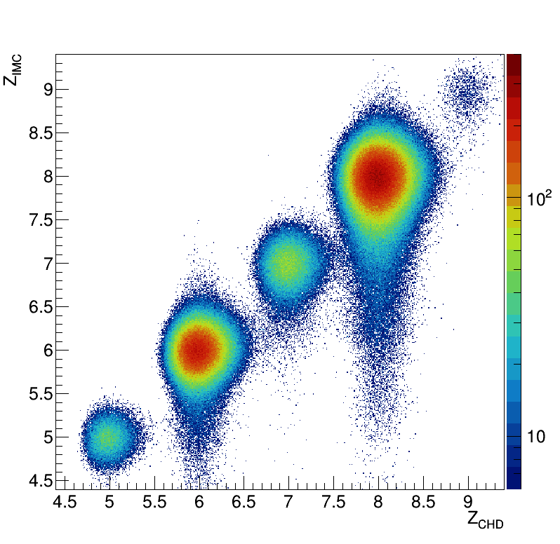
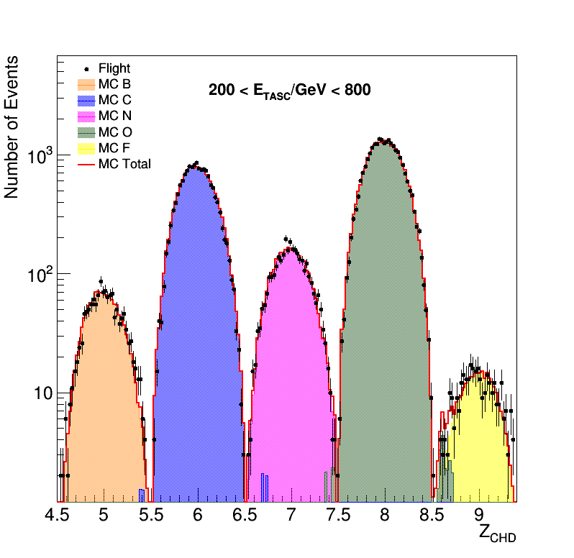
Spectra of Cosmic-ray Nuclei from C to Fe
F
O
With excellent charge-ID of individual elements CALET is
exploring the Table of Elements in the multi-TeV domain
Preliminary Spectra of Carbon – Iron
N
C
B
Under
analysis
200 <E_{TASC}/GeV < 800
C
O
B
N
F

Slide 19
Carbon and Oxygen Energy Spectra
CALET C is consistent with PAMELA and most of the previous experiments. PAMELA did not publish oxygen.
The spectra show a clear hardening around 200 GeV/n.
They have shapes similar to AMS-02 but the absolute normalization is significantly lower ( ~ 27%)
[10 GeV/n, 2.2 TeV/n]
PRL 125 (2020) 251102
(*)
[10 GeV/n, 2.2 TeV/n]
Statistical errors only

Slide 20
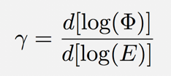

Carbon and Oxygen: Spectral Analysis
PRL 125 (2020) 251102
DPL fit
γ = −2.663 ± 0.014
E₀ = (215 ± 54) GeV/n
Δγ = 0.166 ± 0.042
χ²/dof = 9.0/8
SPL fit
γ = −2.626±0.010
χ²/dof = 27.5/10
Double power-law (DPL) fit
Statistical errors only
Systematic uncertainties are modelled in the χ² minimization function with a set of nuisance parameters.
DPL fit
γ = −2.637±0.009
E₀ = (264 ± 53) GeV/n
Δγ = 0.158 ± 0.053
χ²/dof = 3.0/8
Double power-law
(DPL) fit
SPL fit
γ = −2.622±0.008
χ²/dof = 15.9/10
Single Power Law hypothesis excluded at 3.9σ level for C and 3.2σ for O
20

Slide 21
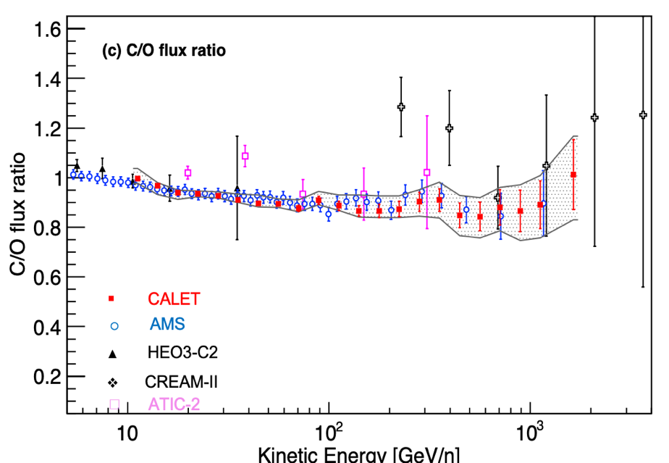
C/O flux ratio
[10 GeV/n, 2.2 TeV/n]
Fit to a constant
0.911± 0.006 @ E> 25 GeV/n
PRL 125 (2020) 251102
Statistical errors only
The C/O flux ratio as a function of energy is in good agreement with the one reported by AMS
Above 25 GeV/n the C/O ratio is well fitted to a constant value of 0.911 ± 0.006 with c²/dof = 8.3/17
→ C and O fluxes have the same energy dependence.

Slide 22
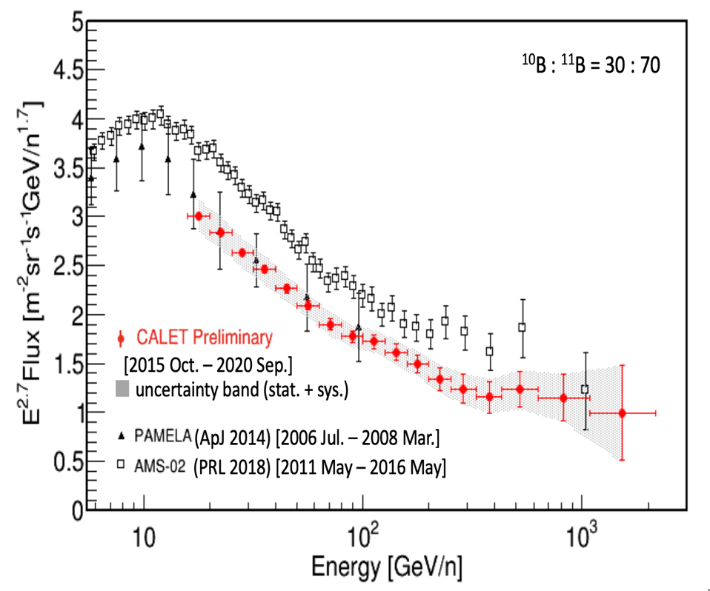
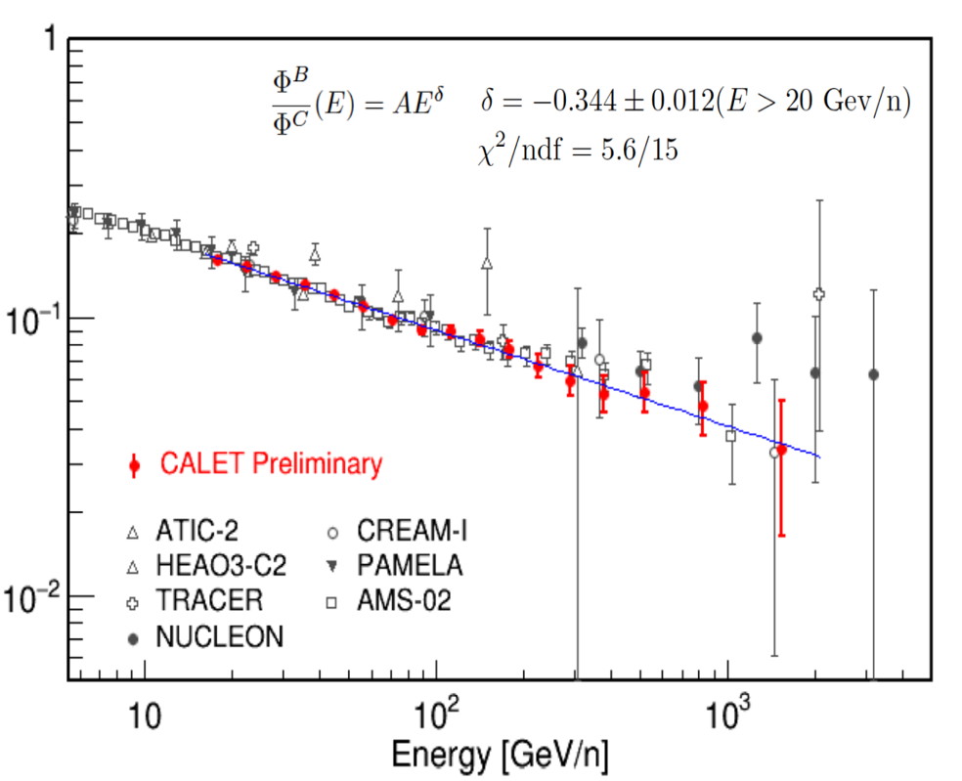
Boron Spectrum and B/C Ratio (preliminary)
Boron energy spectrum
B/C ratio
with ± 10% variation of isotopic ratio → the flux changes by only ~ 2%
B/C
flux normalization is consistent
with PAMELA
SPL fit
γ = −2.626±0.010
χ²/dof = 27.5/10
[16 GeV/n, 2.2 TeV/n]
[16 GeV/n, 2.2 TeV/n]
Statistical errors only

Slide 23
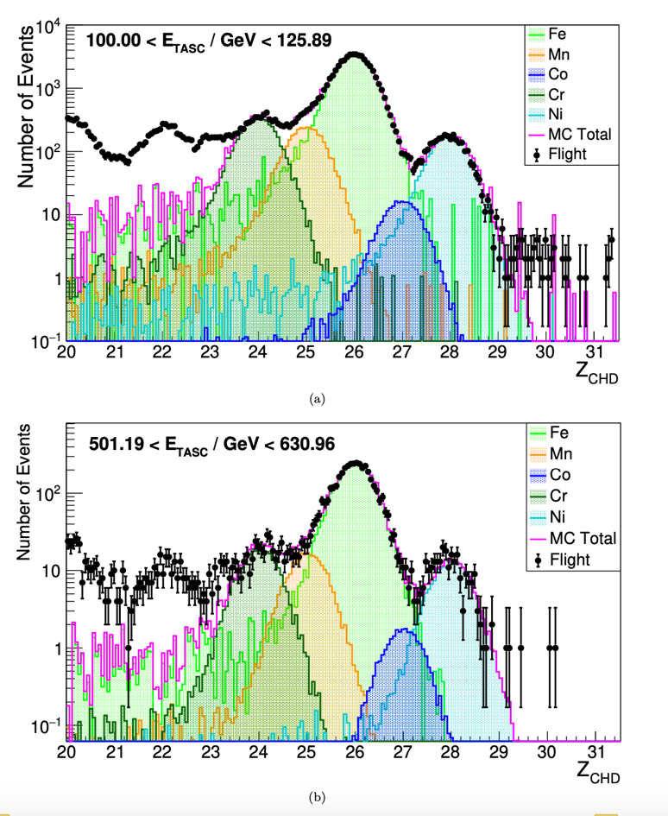
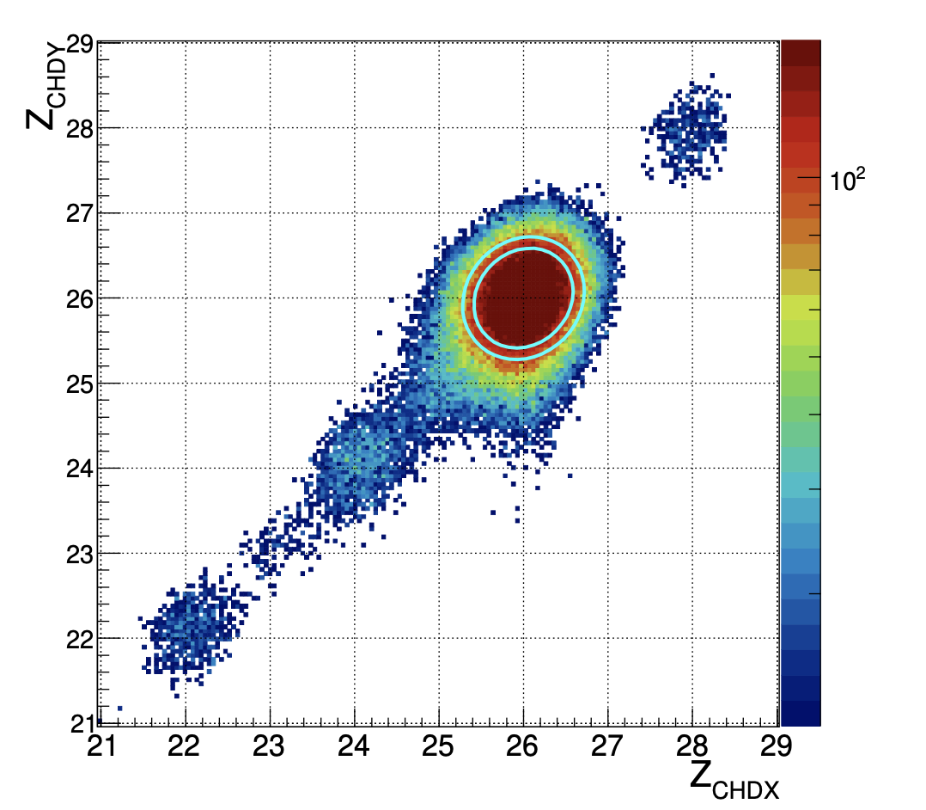
Iron – Analysis (Charge Selection)
Charge measurement with the two CHD layers
Ni
Fe
Mn
Cr
V
Ti

Slide 24
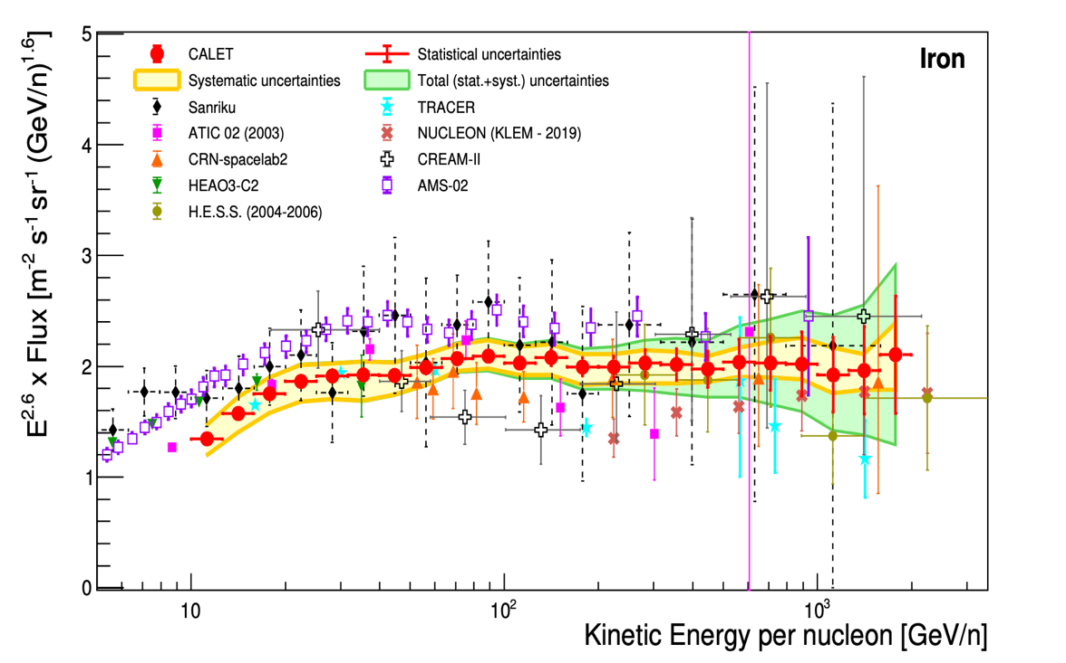
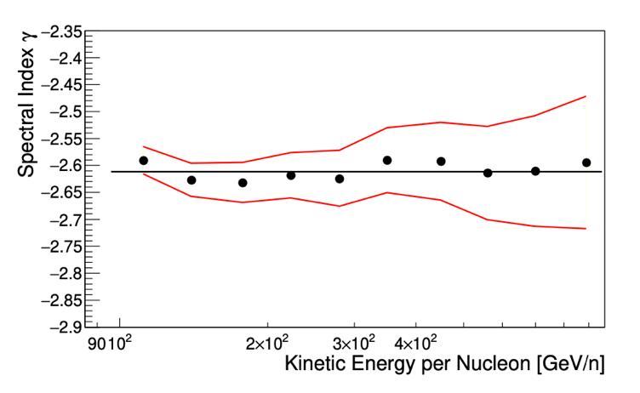
Iron Spectrum
Flux x E^{2.6} vs kinetic energy per nucleon
[10 GeV/n, 2 TeV/n]
analyzed data: Jan, 2016 – May 2020
Iron Single Power Law fit:
50 GeV/n, 2.0 TeV/n
γ = −2.60 ± 0.02(stat) ± 0.02(sys)
with χ²/d.o.f. = 4.2/14
Phys. Rev. Lett. 125, 251102 (2020)
PHYSICAL REVIEW LETTERS 126, 241101 (2021)

Slide 25
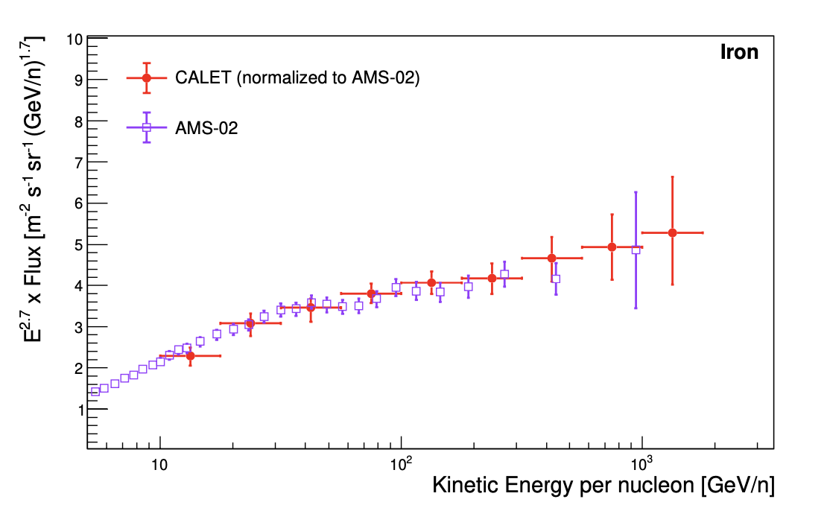
Iron Spectral Shape and Normalization
Flux normalization:
consistent with ATIC 02 and TRACER at low
energy and with CNR and HESS at high energy
in tension with AMS-02 and SANRIKU (balloon)
Spectral shape:
CALET E^{2.7} x Flux vs kinetic energy/n normalized to AMS-02:
- similar spectral shape
- comparable errors above 200 GeV/n
Spectral hardening:
CALET iron data are consistent with an SPL spectrum up to 2 TeV/n.
Beyond this limit, the present statistics and large systematics do not allow to draw a significant conclusion on a possible deviation from a single power law.
AMS-02 Phys. Rev. Lett. 126, 041104 (2021)
CALET Phys. Rev. Lett. 126, 241101 (2021)
[10 GeV/n, 2 TeV/n]
Flux x E^{2.7} normalized to AMS-02(*)
(*) please note that the flux is multiplied by E^{2.7} an not x E^{2.6} as in the previous slide

Slide 26
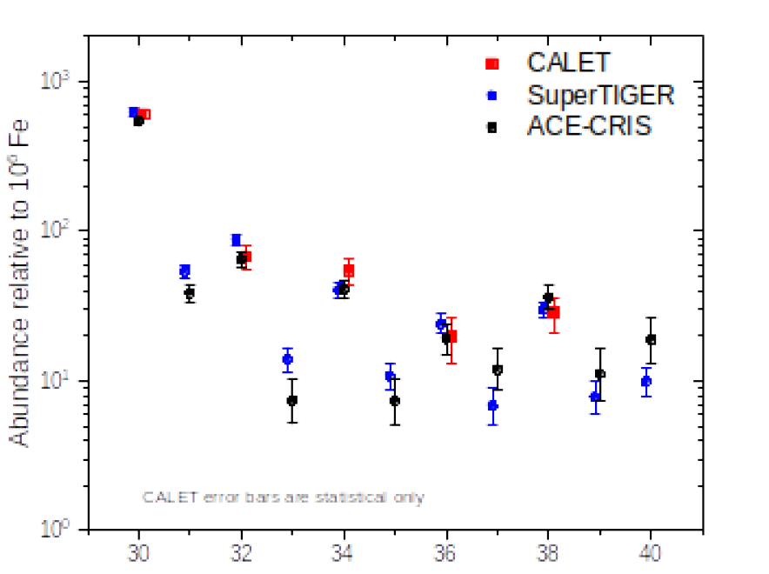
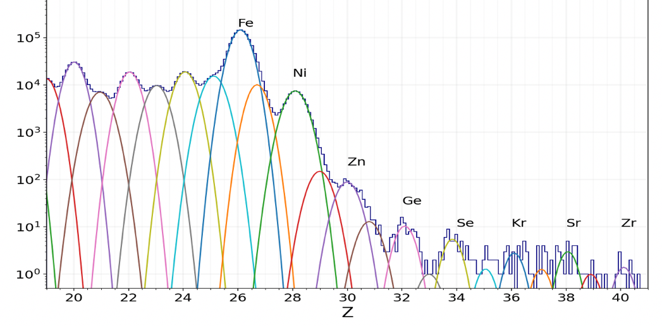
Ultra-heavy cosmic-ray nuclei (26 < Z < 40)
Measurement of the relative abundances
of elements above Fe through ₄₀Zr
A special UH CR trigger uses the CHD and the first 4 layers of the IMC to achieve an expanded
x 4 geometric factor
GF ~ 4400 cm² sr
Zn
Ge
CALET Preliminary
Se
Kr
Sr
Zr
above Ni: Z-even
₃₀Zn, ₃₂Ge, ₃₄Se
are resolved
The CALET UH element ratios relative to Fe
are consistent with Super-TIGER and ACE
abundances.

Slide 27
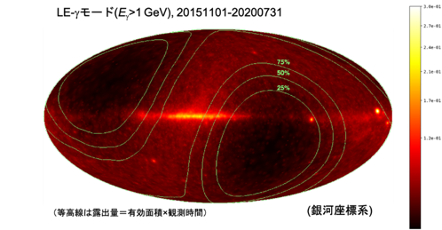
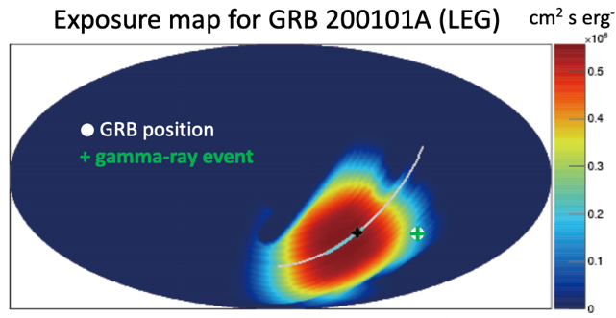
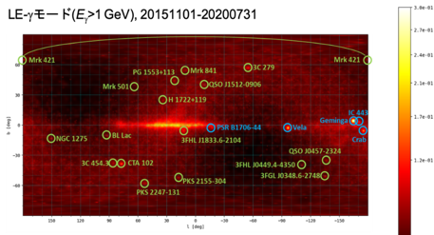
CALET γ–ray Sky (>1GeV) ,GRBs, GW follow-up, DM limits
Gamma-ray sky map LE-γ trigger (E >1 GeV)
1
(detected by CAL)
Δθ：0.59°
E: 4.92 GeV
ΔT: 105 s
    Effective area: ~400 cm² above
    2 GeV
    Angular resolution:
    < 0.2° above
    10 GeV
    Energy resolution: ~5% at 10 GeV
CGBM: dedicated Gammay-Ray Burst Monitor
with energy range 7 keV-20 MeV
Identified bright point-sources (E >1 GeV)
from 2015-10-05 to 2021-07-23
259 GRBs (44.9 GRBs / year)
228 Long (88%) 31 Short (12%)
- Follow-up of LIGO/Virgo GW observations in:
X-ray and γ-ray bands
high-energy γ-in calorimeter
poster:
MM 817
- Limits on DM annihilation into γγ: <σv> < 10⁻²⁸-10⁻²⁵cm⁻³s⁻¹
- Limits on DM decay χ → γν etc.: τ_{DM} > 10³⁰s (m_{DM}>100 GeV)
oral:
GAD 517

Slide 28
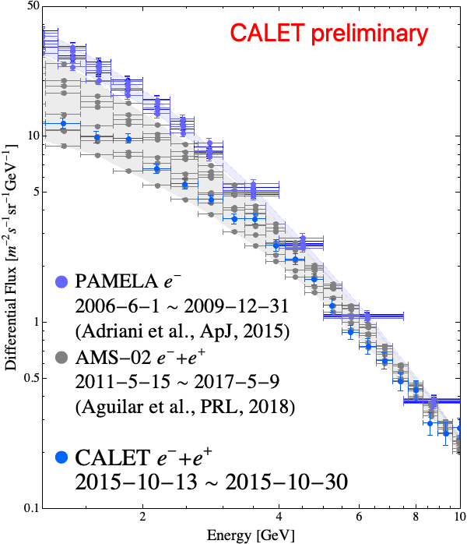
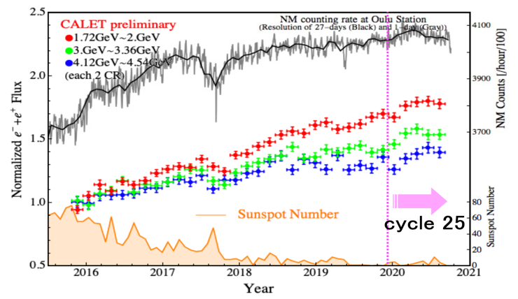
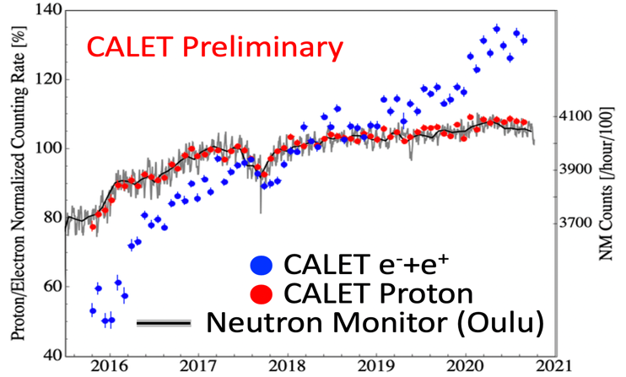
Solar modulation
Since the start of observations in 2015/10, a steady increase in the 1-10 GeV all-electron flux has been observed.
In the past two years, the flux has reached the maximum flux observed with PAMELA during the previous solar minimum.
Good correlation of NM counting rate at Oulu station (black points) with the CR
e⁻ + e⁺ flux increase
in the 1-10 GeV until ~half a year after the beginning the new solar cycle 25.
The flux has now started decreasing.
Long-term variation of all-electron flux observed by CALET
The count rate increase of CR e⁻ + e⁺ is found to be larger than that of CR protons. Consistent with the expected
CHARGE SIGN dependence of the solar modulation.

Slide 29
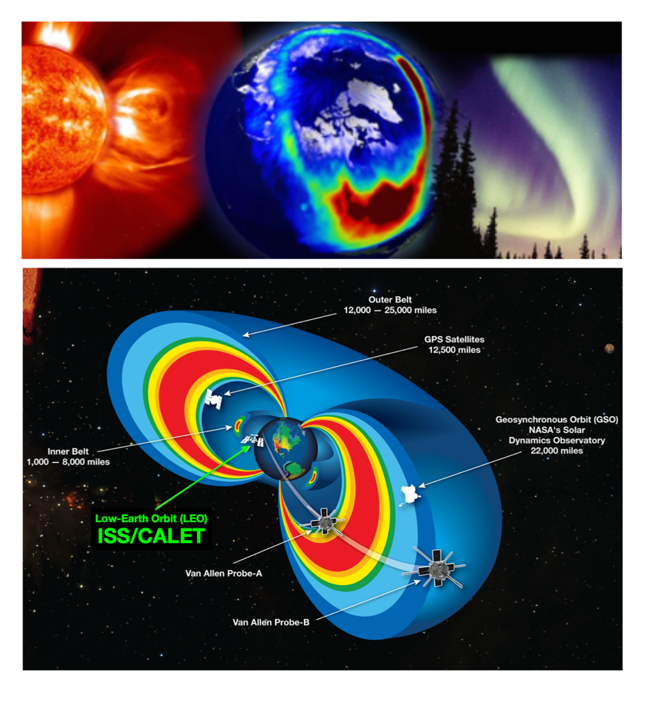
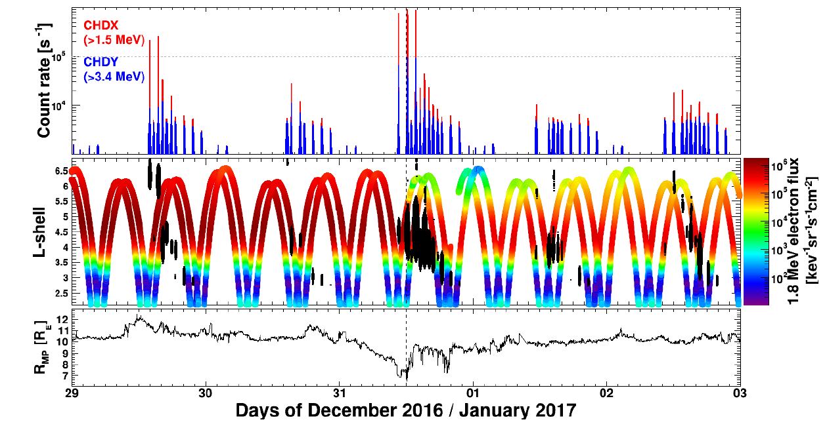
Space Weather Phenomena with CALET
EMIC-Wave Driven Electron Precipitation observed by
CALET on the International Space Station
( accepted by Geophysical Research Letters )
Observations by CALET and Van Allen Probes
(a)
(b)
(c)
Time profile of electron, interplanetary and geomagnetic data between 29 December 2016 and 3 January 2017. From top to bottom: CHDX and CHDY count rates (a); 1.8 MeV electron intensity (color code) measured by the REPT instrument (b); the magnetopause standoff distance (c). The dashed vertical line marks the arrival of a HSS at ∼12UT on December 31.

Slide 30
Main Science Goals and Status of the Analysis
Scientific Objectives | Observables | Energy Reach | Reported | Reference | Present
Cosmic-ray origin and acceleration | Electron spectrum | 1 GeV – 20 TeV | to 4.8 TeV | PRL 120, 261102 (2018) | 11 GeV – 4.8 TeV
 | Proton spectrum | 10 GeV – 1 PeV | to 10 TeV | PRL 122, 181102 (2019) | 30 GeV – 60 TeV
 | Helium spectrum | 10 GeV – 1 PeV | preliminary | preliminary | 50 GeV – 50 TeV
 | Carbon and oxygen spectra | 10 GeV – 1 PeV | to 2.2 TeV/n | PRL 125, 251102 (2020) | 10 GeV/n – 2.2 TeV/n
 | Iron spectrum | 10 GeV – 1 PeV | to 2 TeV/n | PRL 125,241101 (2021) | 50 GeV/n – 2 TeV/n
 | Elemental spectra of primaries | 10 GeV – 1 PeV | to 100 TeV | ICRC 2019, 034 | 10 GeV – 100 TeV
 | Ultra-heavy abundances | > 600 MeV/n | > 600 MeV/n | ICRC 2019, 130 | > 600 MeV/n
CR propagation | B/C and secondary-to-primary ratios | Up to some TeV/n | to 200 GeV/n | ICRC 2019, 034 | 16 GeV/n – 2.2 TeV/n
Nearby electron sources | Electron spectral shape | 100 GeV – 20 TeV | to 4.8 TeV | ICRC 2019, 142 | to 4.8 TeV
Dark matter | Signatures in e/γ spectra | 100 GeV–20TeV (e) 10 GeV-10TeV (γ) | to 4.8 TeV (e) to 600 GeV (γ) | ICRC2019 , 533 | to 4.8 TeV
Gamma rays | Diffuse & point sources | 1 GeV – 10 TeV | 1 GeV – 1 TeV | ApJS 238:5 (2018) | 1 GeV – 1 TeV
Heliospheric physics | Solar modulation | 1 GeV – 10 GeV | 1 – 10 GeV | ICRC 2019, 1126 | 1 – 10 GeV
Gamma-ray transients | GW follow-up and GRB analysis | 7 keV–20MeV (CGBM) 1 GeV-1TeV (ECAL) | 7 KeV-20MeV | ApJL 829:L20 (2016) | 7 keV–20MeV (CGBM) > 1 GeV (ECAL)
Space weather | Relativistic electron precipitation | > 1.5 MeV | > 1.5 MeV | Geophys.Res.Lett,43 (2016) | > 1.5 MeV

Slide 31

CALET: Summary and Future Prospects
CALET was successfully launched in August 2015 and installed on the Japanese Experiment Module – Exposure Facility on the ISS.
More than 6 years of excellent performance and remarkable stability of the instrument since the start of data taking on Oct. 23, 2015.
Linearity in the energy measurements established up to 10⁶ MIP
[ Astropart. Phys. 91, 1 – 10 (2017) ]
Continuous on-orbit calibration updates
HE trigger operational for > 2100 days with > 85% live time fraction
Total number of > GeV triggers ~3.0 billion
Extended operations are approved by JAXA/NASA/ASI in March 2021
through the end of 2024.
＊) We greatly appreciate JAXA staffs for perfect support of the CALET operation
at the Tsukuba Space Center of JAXA !!

